Slide 1
Semiconductor Diode Applications

Slide 2
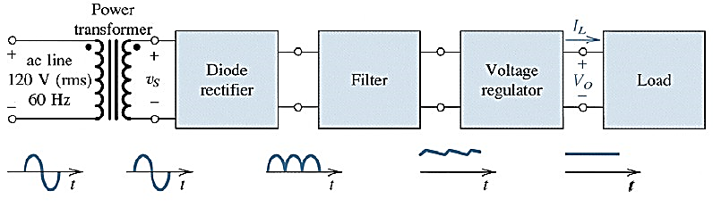
Rectifier
One of the most important applications of diodes is in the design of rectifier circuits.
Rectifiers convert ac power to dc power.
Rectifiers form the basis for electronic power suppliers and battery charging circuits.
Fig.: Complete power supply with transformer, rectifier, filter, and regulator

Slide 3
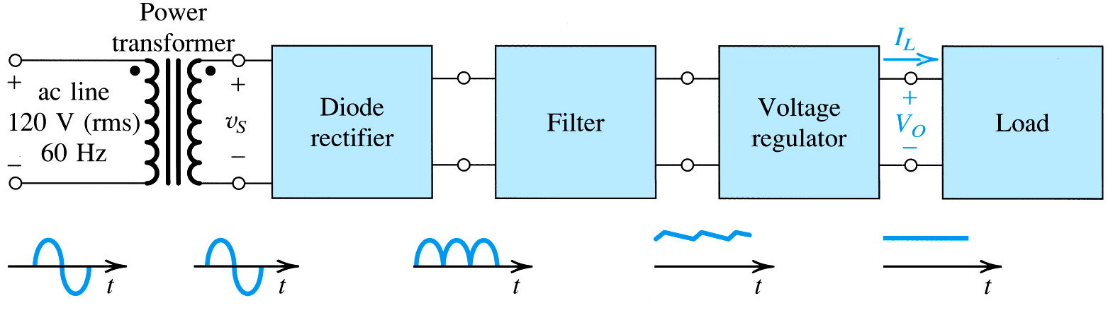
Step-1: Decrease RMS magnitude of AC wave via power transformer
step -2: convert full-wave AC signal to full-wave rectified signal (still time-varying and periodic)
step -3: employ low-pass filter to reduce wave amplitude by > 90%
step -4: employ voltage regulator to eliminate ripple
step -5: supply dc load .
Block diagram of a dc power supply
Notes:
The diagrams indicate a “full-wave” rectifier.

Slide 4
Rectifier
Rectifier are mainly two types:
Half wave Rectifiers
Full wave Rectifiers.
Bridge rectifier
Center tap transformer rectifier

Slide 5
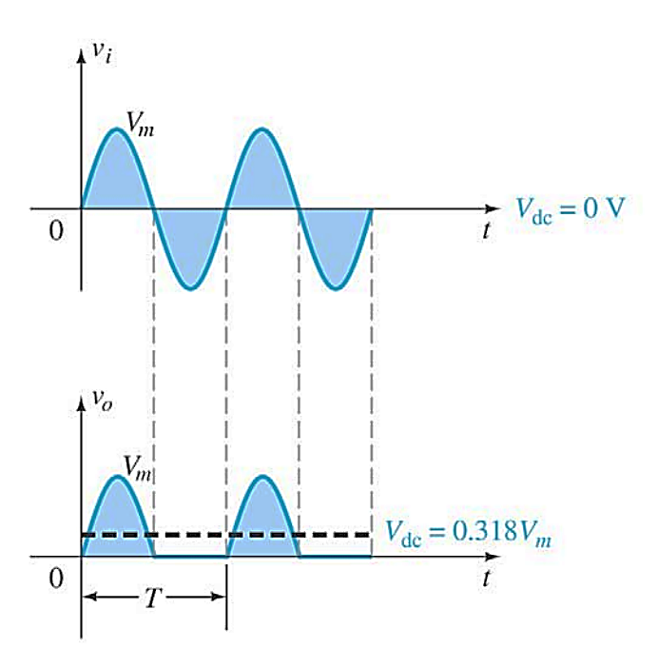
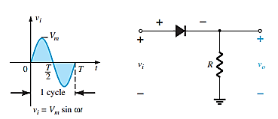
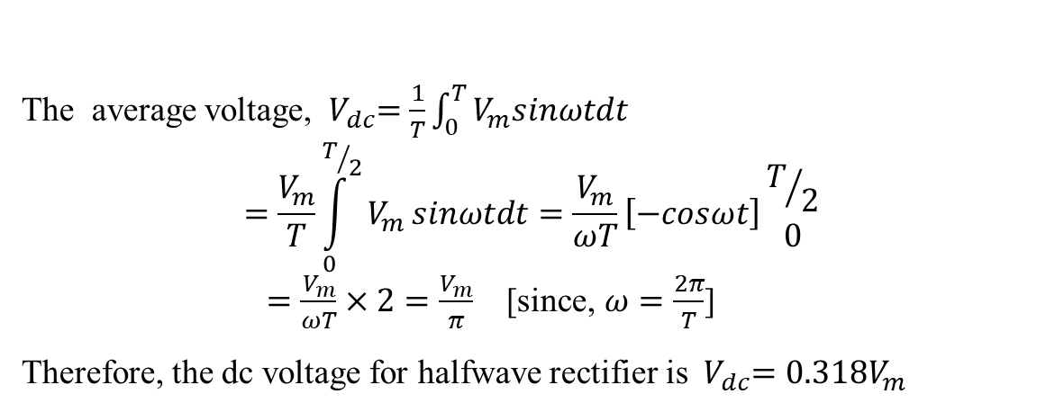
Half-wave Rectifier
Half wave Rectifiers: A rectifier that allows only one-half cycle of an ac voltage waveform to establish a dc level is called half wave rectification.
Hal-wave rectifier circuit with AC input
Rectifier Output for ideal diode
The average voltage, ${ V}_{dc}=\frac{1}{T}\int_{0}^{T}{V_{m}sinωtdt}$
$$=\frac{V_{m}}{T}\int_{0}^{T/2}{V_{m}}sinωtdt=\frac{V_{m}}{ωT}\left[−cosωt\right]{T/2 \atop 0}$$
$=\frac{V_{m}}{ωT}×2=\frac{V_{m}}{π}$ [since, $ω=\frac{2π}{T}$]
Therefore, the dc voltage for halfwave rectifier is ${ V}_{dc}=0.318V_{m}$

Slide 6
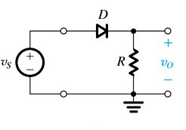
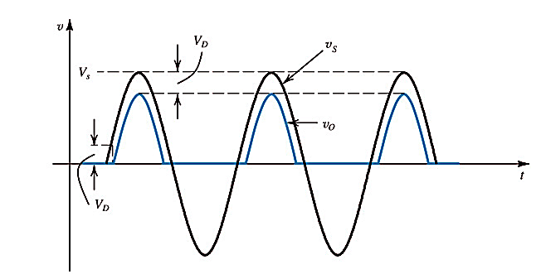
Effect of Using a Real Diode
If simplified diode model is employed.
The diode is conducted after the voltage supplied is more than 0.7V as shown below
So peak value of output is reduced, hence the dc voltage will be reduced.
V_{dc} ≅ 0.318(V_{m} − V_{K} )

Slide 7
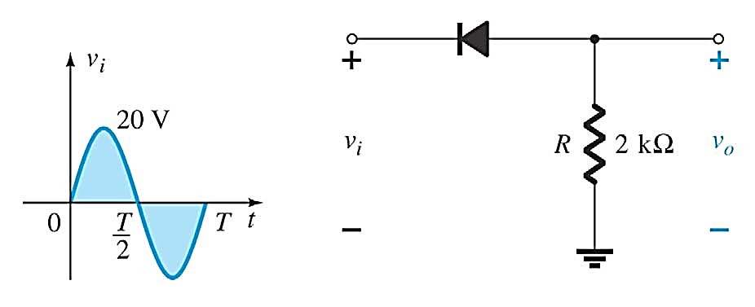
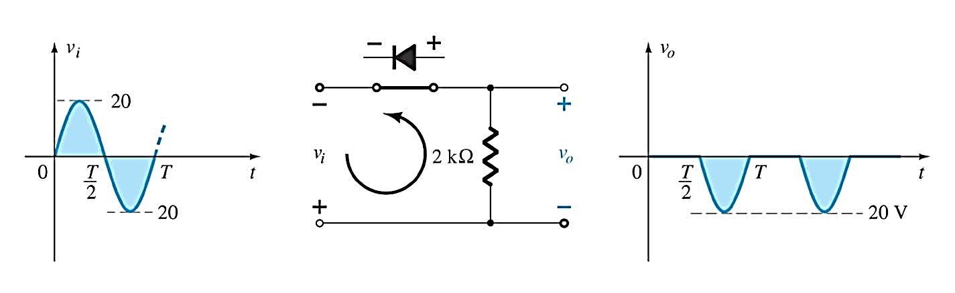
Half-Wave Rectification
Example: Circuit as below
Sketch the output v_{o} and determine dc level of the output voltage for ideal diode
What is the practical diode
The V_{m} is increase to 200V
Solution:
Ideal diode circuit:
V_{dc}≅ 0.318(V_{m})
= −0.318(20V )
= −6.36V
(a)

Slide 8
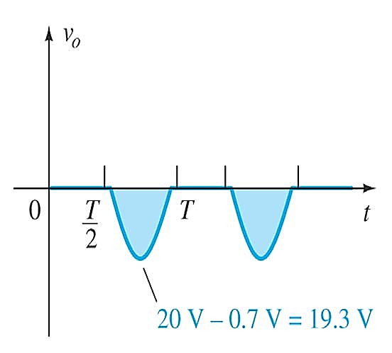
V_{dc} ≅ 0.318(V_{m} − V_{K} ) = −0.318(20V − 0.7V ) = −6.14V
(b)
Drop about 0.22V or 3.5 %
V_{dc} ≅ 0.318(V_{m} ) = −0.318(200V ) = −63.6V
(ideal)
(C)
V_{dc} ≅ 0.318(V_{m} − V_{K} ) = −0.318(200V − 0.7) = −63.38V
Drop about 0.22V or 0.35%
(practical)

Slide 9
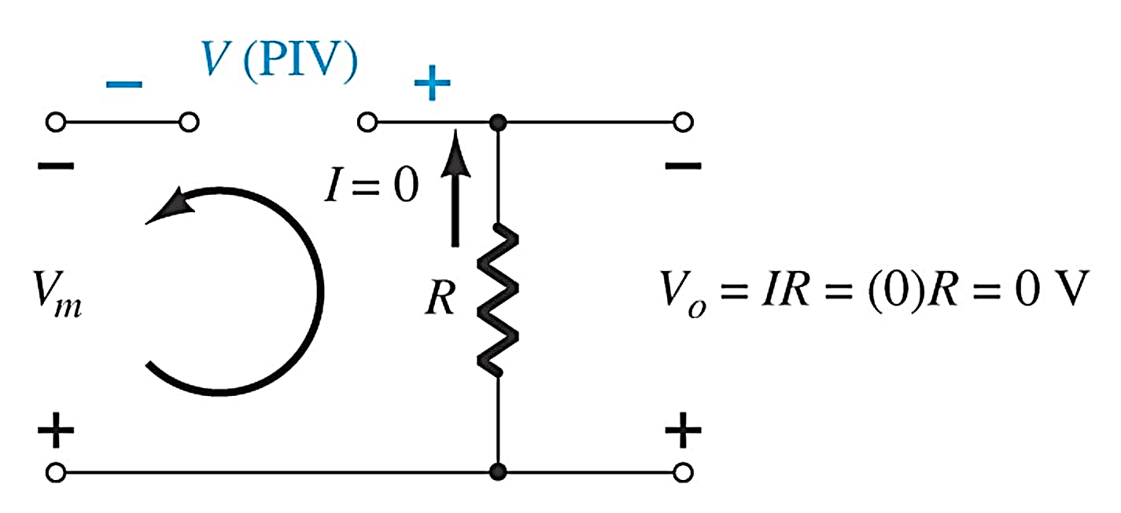
Diode Rating
The maximum value of the reverse voltage that a diode can withstand without damaging itself is known as its Peak Inverse Voltage (PIV).
PIV of diode must be greater than the applied voltage
This rating of PIV is given and described in the datasheet provided by the manufacturer.
It is usually prudent to select a diode that has a reverse breakdown voltage at least 20% greater than the expected PIV.
PIV(rating) > V_{m} for half –wave rectifier

Slide 10
Half-wave Rectifier
Advantages:
Simple construction
Less number of components are required
Small size
Disadvantages:
More amount of ripple content
Transformer utilization factor is very low.
Rectification efficiency is low
Generates harmonics
Low output voltage or current
Applications:
It is used for applications where constant DC voltage is not very essential
We can use in the power supplies

Slide 11
Full-Wave Rectification
Full wave Rectifiers:
A rectifier that allows full cycle of an ac voltage waveform to establish a dc level is called Full wave rectification.
Full-wave rectification produces a greater DC output
Half-wave: V_{dc} = 0.318V_{m}
Full-wave: V_{dc} = 0.636V_{m}

Slide 12
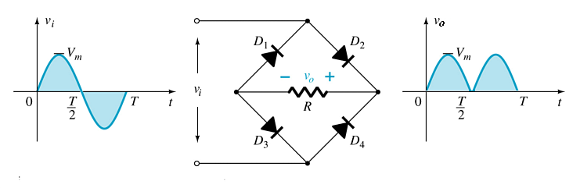
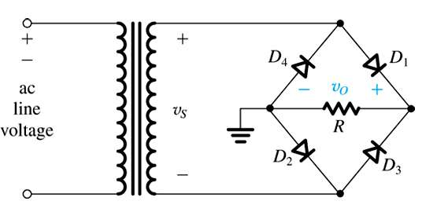
Full-Wave Bridge Rectifier
A full-wave rectifier with four diodes that are connected in a bridge configuration.
Four diodes are connected in a bridge configuration
V_{DC} = 0.636V_{m}

Slide 13
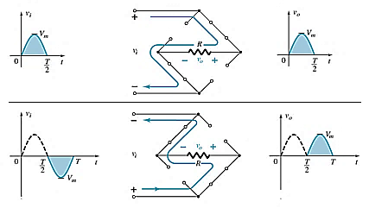
Full-Wave Bridge Rectifier
The bridge rectifier circuit.

Slide 14
Full-Wave Bridge Rectifier
The bridge rectifier circuit.

Slide 15
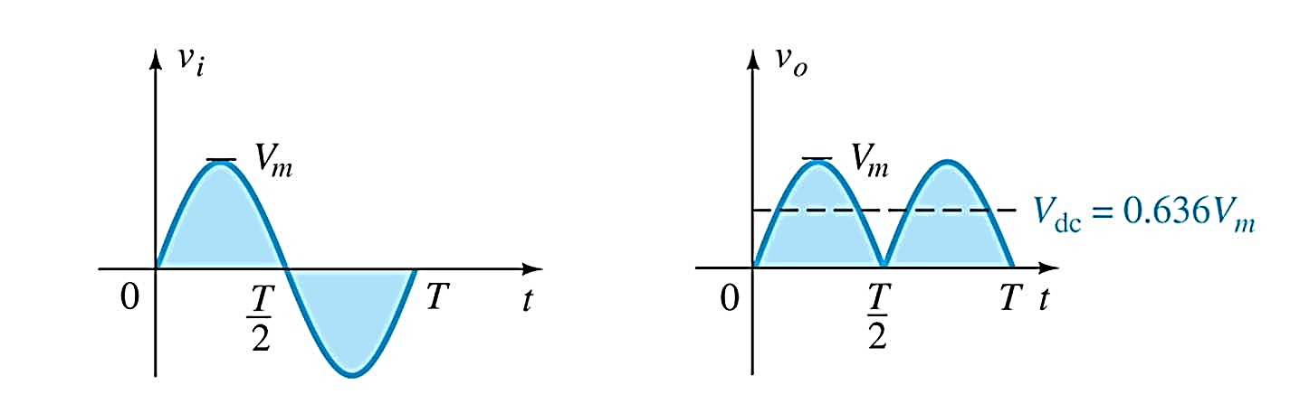
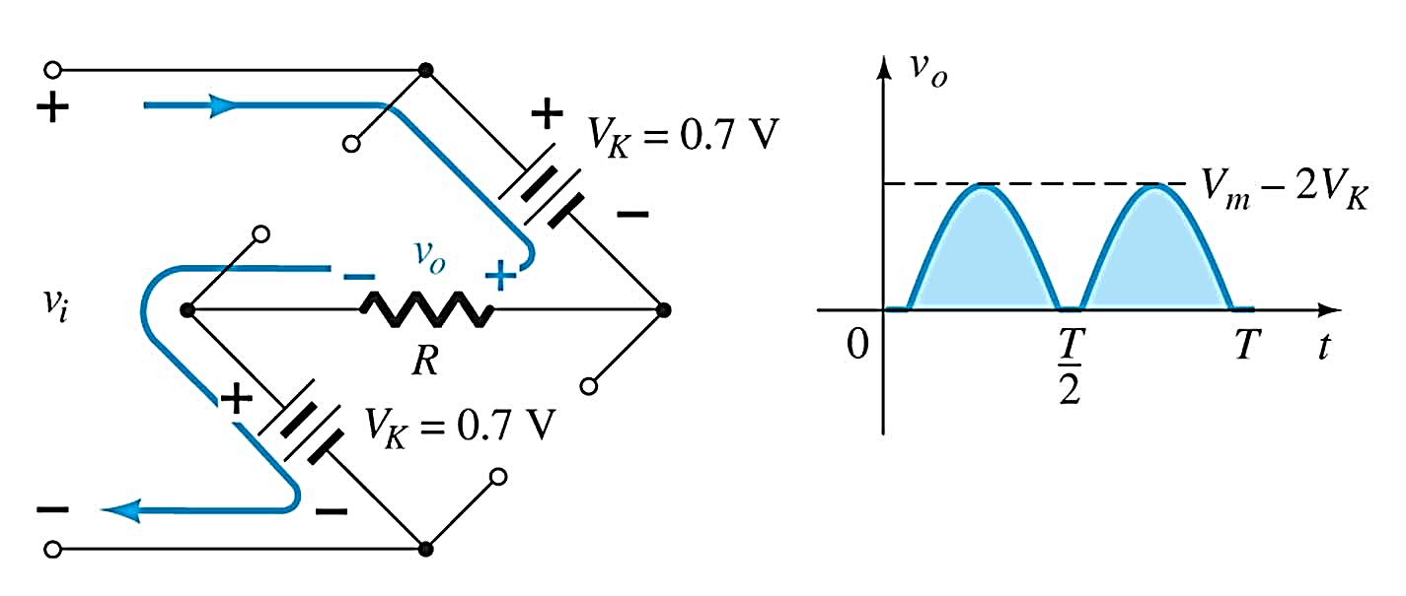
V_{dc} = 2(0.318V_{m} ) = 0.636V_{m}
Full-Wave Bridge Rectification
Ideal diode
Practical diode
V_{dc} ≅ 0.636(V_{m} − 2V_{K} )
The effect of using a real diode

Slide 16
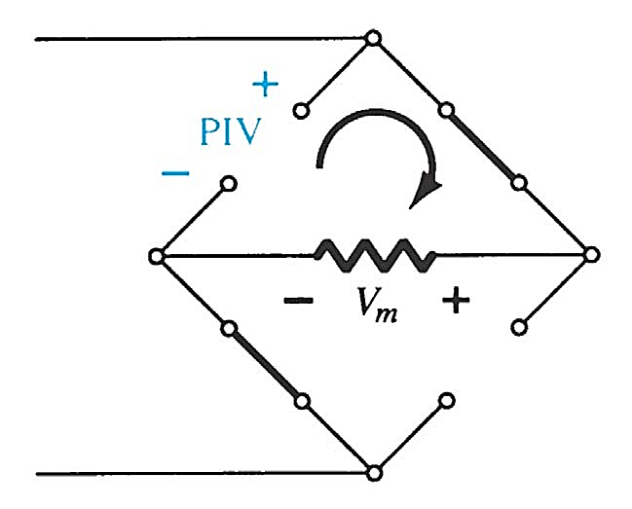


Diode Rating
For ideal diode
$$PIV≥V_{m}$$
For real diode
$$PIV≥V_{m}−V_{K}$$

Slide 17
Full-wave Bridge Rectifier
Advantages:
No need for center-tapped transformers
High average output voltage
Rectifier efficiency is high
Transformer utilization factor is high
Disadvantages:
The number of diode is four
Series connection of TWO diodes will reduce output voltage.
PIV = V_{m} – V_{K}
Applications:
Laboratory dc power supplies
High current power supplies
Battery charger
DC power supplies for various electronic circuits

Slide 18
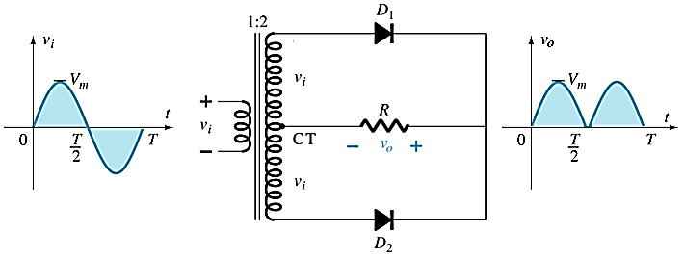
Center-Tapped Transformer
Center-Tapped Transformer Rectifier
Requires
Two diodes
Center-tapped transformer
Output:
V_{DC} = 0.636V_{m}
PIV > 2 V_{m}
The above output is for ideal diode

Slide 19
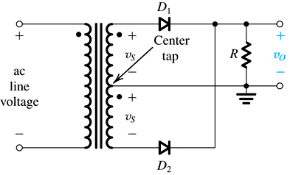
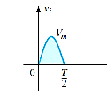
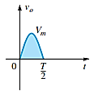


Center-Tapped Transformer
When instantaneous source voltage is positive, D₁ conducts while D₂ blocks…
$$v_{i}$$
$$v_{i}$$
The center tap transformer rectifier circuit.

Slide 20
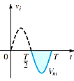
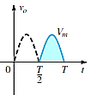
Center-Tapped Transformer
when instantaneous source voltage is negative, D₂ conducts while D₁ blocks
The center tap transformer rectifier circuit.

Slide 21
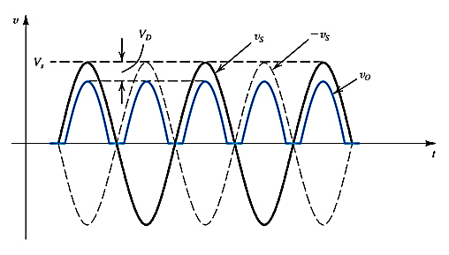
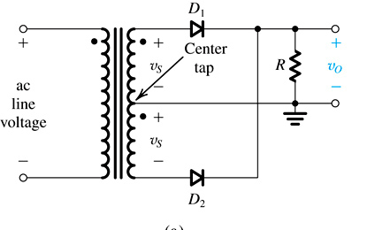

Effect of Real Diode
$$V_{m}−V_{k}$$
V_{dc} ≅ 0.636(V_{m} − V_{K} )
The effect of using a real diode

Slide 22

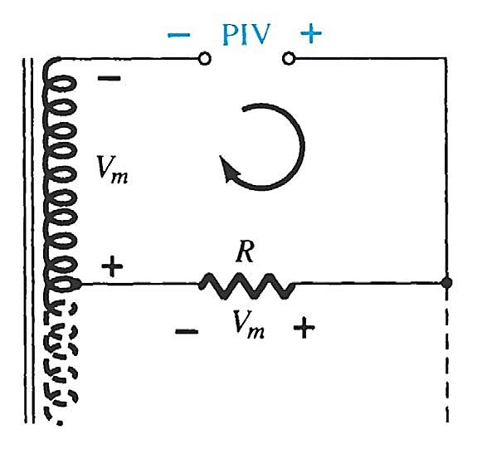
PIV.
Apply KVL
^{PIV = V}secondary
+ V_{R} = V_{m}
+ V_{m} = 2V_{m}
PIV ≥ 2V_{m}
Therefore
For practical diode, PIV for center tap = 2V_{m} – V_{K}

Slide 23
Full-wave Rectifier with Center-Tapped Transformer
Advantages:
Low ripple factor as compared with half-wave rectifier.
Better rectification efficiency
Better transformer utilization factor
Disadvantages:
Since PIV is 2V_{m ,}size of the diodes is larger and they are most costly
Cost of center tapped transformer is high
Applications:
Laboratory dc power supplies
High current power supplies
Battery charger
DC power supplies for various electronic circuits

Slide 24
Summary of Rectifier Circuits
Rectifier | Ideal V_{DC} | Realistic V_{DC}
Half Wave Rectifier | V_{DC} = 0.318V_{m} | V_{DC} = 0.318V_{m} – 0.7
Bridge Rectifier | V_{DC} = 0.636V_{m} | V_{DC} = 0.636V_{m} – 2(0.7 V)
Center-Tapped Transformer Rectifier | V_{DC} = 0.636V_{m} | V_{DC} = 0.636V_{m} – 0.7 V
V_{m} = peak of the AC voltage.
In the center tapped transformer rectifier circuit, the peak AC voltage is the transformer secondary voltage to the tap.
The above realistic value is true for only silicon diode.

Slide 25
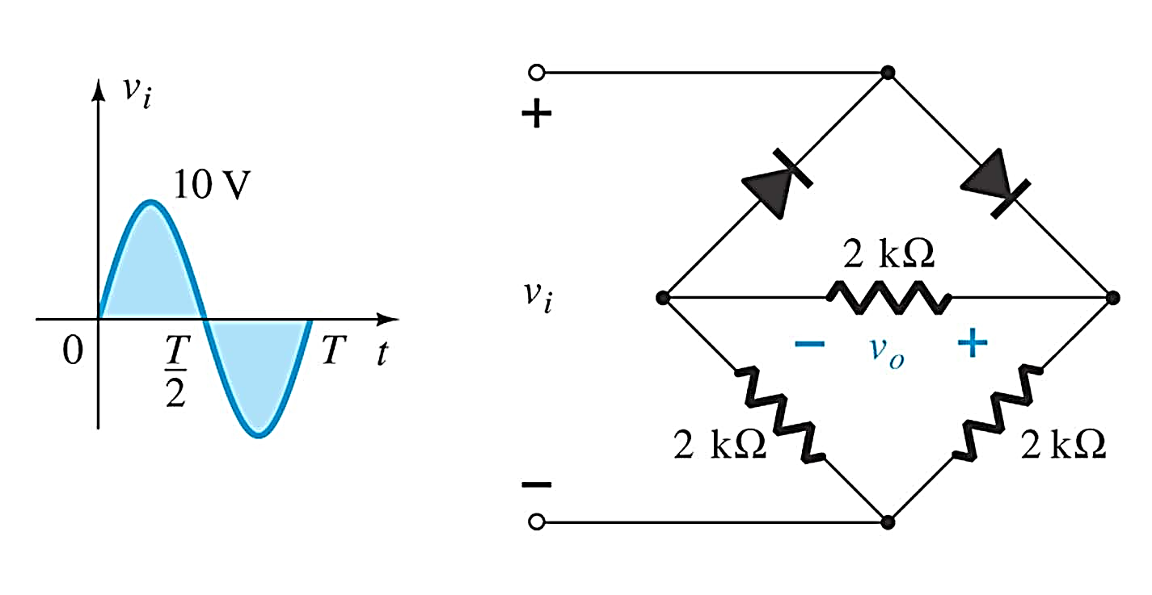
Determine the output for the network below and calculate the output dc level and the required PIV of each diode.

Slide 26
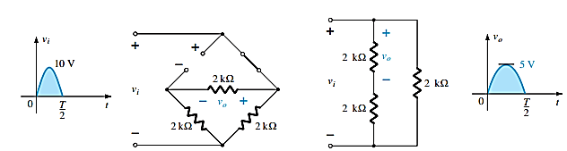
Solution:
D₁
D₂
For positive half cycle, diode 2 is on and 1 is off, which is shown in the following figure
Equivalent circuit
Redrawn network
Output for positive cycle

Slide 27
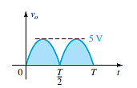
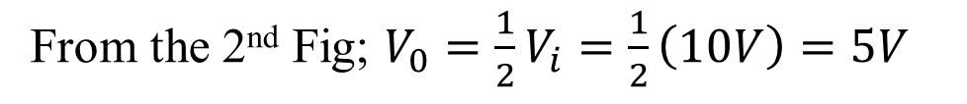
Solution:
From the 2nd Fig; $V_{0}=\frac{1}{2}V_{i}=\frac{1}{2}\left(10V\right)=5V$
Therefore, $V_{dc}=0.636V_{0}=0.636\left(5V\right)=3.18V$
Again, for the negative half cycle, diode 1 is on and 2 is off and we get the same result of positive half cycle.
3.18V
V_{dc}
Resulting output
PIV ≥ V_{m} = 5V

Slide 28
Practical Applications
Rectifier Circuits
Conversions of AC to DC for DC operated circuits
Battery Charging Circuits
Simple Diode Circuits
Protective Circuits against
Overcurrent
Polarity Reversal
Currents caused by an inductive kick in a relay circuit
Zener Circuits
Overvoltage Protection
Setting Reference Voltages
28

